Slide 1

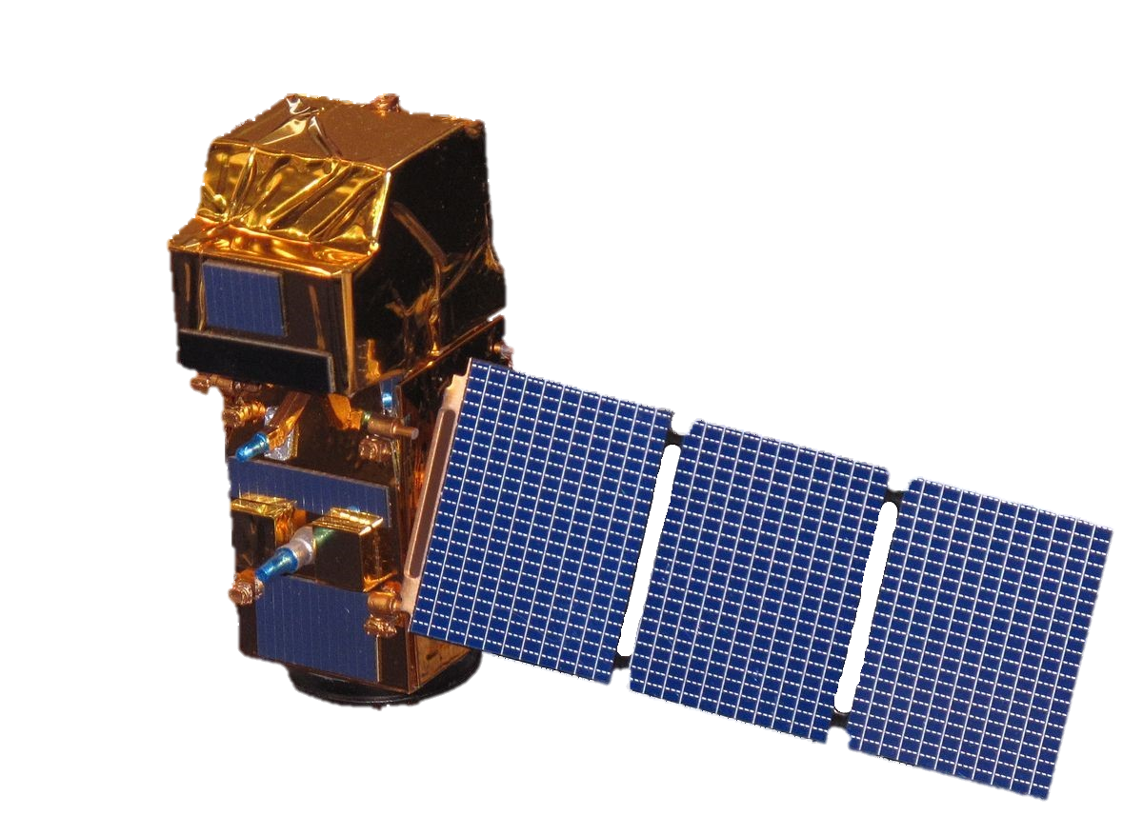

Day 2: All in the Family: Earth Science Sensors
Today’s Class:
Results of intake survey
Commonly used remote sensing sensors
Matching project ideas to sensors
“Specialist” sensors (the great unknown…)
Sentinel-2

Slide 2
Day 2: All in the Family: Picking a Data Product
Today’s Class:
Results of intake survey
Commonly used remote sensing sensors
Matching project ideas to sensors
“Specialist” sensors (the great unknown…)
Notes from Monday
Slides are now available on Canvas
Lab Sections
Lab starts this week!
We will need you to attend your registered lab section; if you need to change lab section, you should formalize it through GOLD
Monday is full, Wednesday has only 11 people in it
Sentinel-2

Slide 3
Survey Insight #1: Similar science interests, diverse technical interests
Common science interests:
(a lot of you had these in common!)
Climate change
Meteorology
Ocean/marine science
Agriculture
Land management
Diverse technical interests:
(your answers were all over the place!)
Drones/UAVs
NDVI
LiDAR
Google Earth Engine
Nighttime Lights
Classification
Machine learning

Slide 4
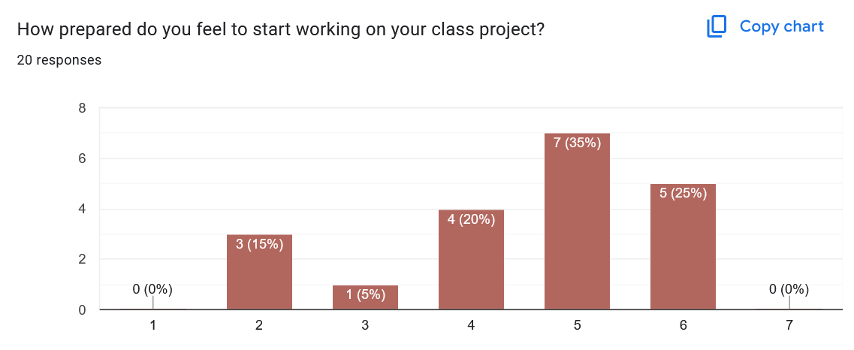
Survey Insight #2: A lot of you have pieces of a project, but not the whole picture
I don’t know where to begin
I have a solid idea and I’m ready to run

Slide 5
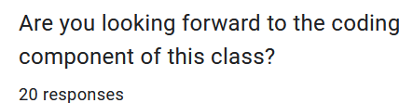
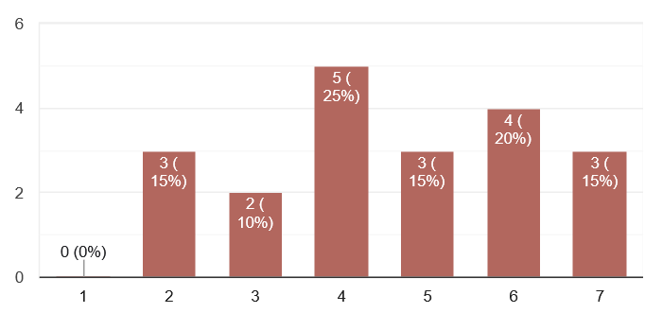
Survey Insight #3: A lot of you are nervous-about-but-interested-in coding
About half of you who gave a text response mentioned being either nervous about coding or feeling like you’re bad at it.
Many of you also said you know coding will be valuable in your career.
Several of you said you wanted more practice with Earth Engine, either for your project or for your personal goals.
Earth Engine was my first coding language!
Not at all
Absolutely

Slide 6
Looking ahead to the rest of the quarter…
Main course goals were (a) making a killer project and (b) learning to apply material from 115A and 115B. This is great news!

Slide 7
Looking ahead to the rest of the quarter…
Main course goals were (a) making a killer project and (b) learning to apply material from 115A and 115B. This is great news!
Requests for clarity on expectations/requirements for points. Thank you for this! Also requests for slides in advance. I will do my best!

Slide 8
Looking ahead to the rest of the quarter…
Main course goals were (a) making a killer project and (b) learning to apply material from 115A and 115B. This is great news!
Requests for clarity on expectations/requirements for points. Thank you for this! Also requests for slides in advance. I will do my best!
Material that multiple people requested we revisit:
Classification → We will be spending a week talking about this; I will tailor those classes based on your expressed interests

Slide 9
Looking ahead to the rest of the quarter…
Main course goals were (a) making a killer project and (b) learning to apply material from 115A and 115B. This is great news!
Requests for clarity on expectations/requirements for points. Thank you for this! Also requests for slides in advance. I will do my best!
Material that multiple people requested we revisit:
Classification → We will be spending a week talking about this; I will tailor those classes based on your expressed interests
More foundational Earth Engine skills → I’m modifying next Wednesday’s class to focus on this

Slide 10
Looking ahead to the rest of the quarter…
Main course goals were (a) making a killer project and (b) learning to apply material from 115A and 115B. This is great news!
Requests for clarity on expectations/requirements for points. Thank you for this! Also requests for slides in advance. I will do my best!
Material that multiple people requested we revisit:
Classification → We will be spending a week talking about this; I will tailor those classes based on your expressed interests
More foundational Earth Engine skills → I’m modifying next Wednesday’s class to focus on this
Creating a workflow/flow chart → Adding this to a later lab

Slide 11
Looking ahead to the rest of the quarter…
Main course goals were (a) making a killer project and (b) learning to apply material from 115A and 115B. This is great news!
Requests for clarity on expectations/requirements for points. Thank you for this! Also requests for slides in advance. I will do my best!
Material that multiple people requested we revisit:
Classification → We will be spending a week talking about this; I will tailor those classes based on your expressed interests
More foundational Earth Engine skills → I’m modifying next Wednesday’s class to focus on this
Creating a workflow/flow chart → Adding this to a later lab
Image correction in general – geometric, atmospheric – this is a hard one. Come to office hours

Slide 12
Questions you had for me…
What is your dream for remote sensing in the future?
A spaceborne imaging spectrometer!

Slide 13
Questions you had for me…
What is your dream for remote sensing in the future?
A spaceborne imaging spectrometer!
What is your favorite National Park in New Hampshire?
It’s devastating, but…

Slide 14
Questions you had for me…
What is your dream for remote sensing in the future?
A spaceborne imaging spectrometer!
What is your favorite National Park in New Hampshire?
It’s devastating, but…
What types of jobs would you recommend in remote sensing?
Many “remote sensing” jobs are hidden as GIS jobs.
Remote sensing specific jobs often (but not always)
require graduate education.

Slide 15
Questions you had for me…
What is your dream for remote sensing in the future?
A spaceborne imaging spectrometer!
What is your favorite National Park in New Hampshire?
It’s devastating, but…
What types of jobs would you recommend in remote sensing?
Many “remote sensing” jobs are hidden as GIS jobs.
Remote sensing specific jobs often (but not always)
require graduate education.
How do I highlight GIS/remote sensing skills on a resume?
We will be talking about this!

Slide 16
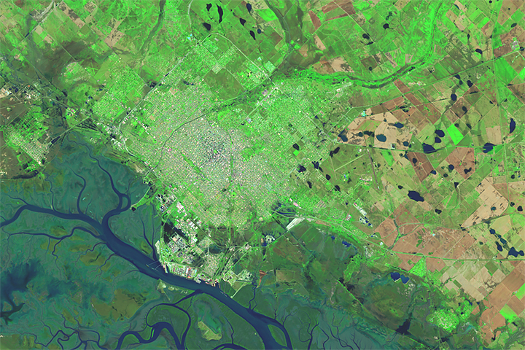
The “Who’s Who” of
remote sensing
The perfect project idea can be ruined by imperfect data availability!

Slide 17

The Landsat Series
The grandma of remote sensing (she’s been with us since 1972!)
When in doubt – Go Landsat!
Quick Facts:
15 meter spatial resolution in panchromatic
30 meter spatial resolution in visible/NIR/SWIR
100 meter spatial resolution in thermal
~14 days between acquisitions

Slide 18
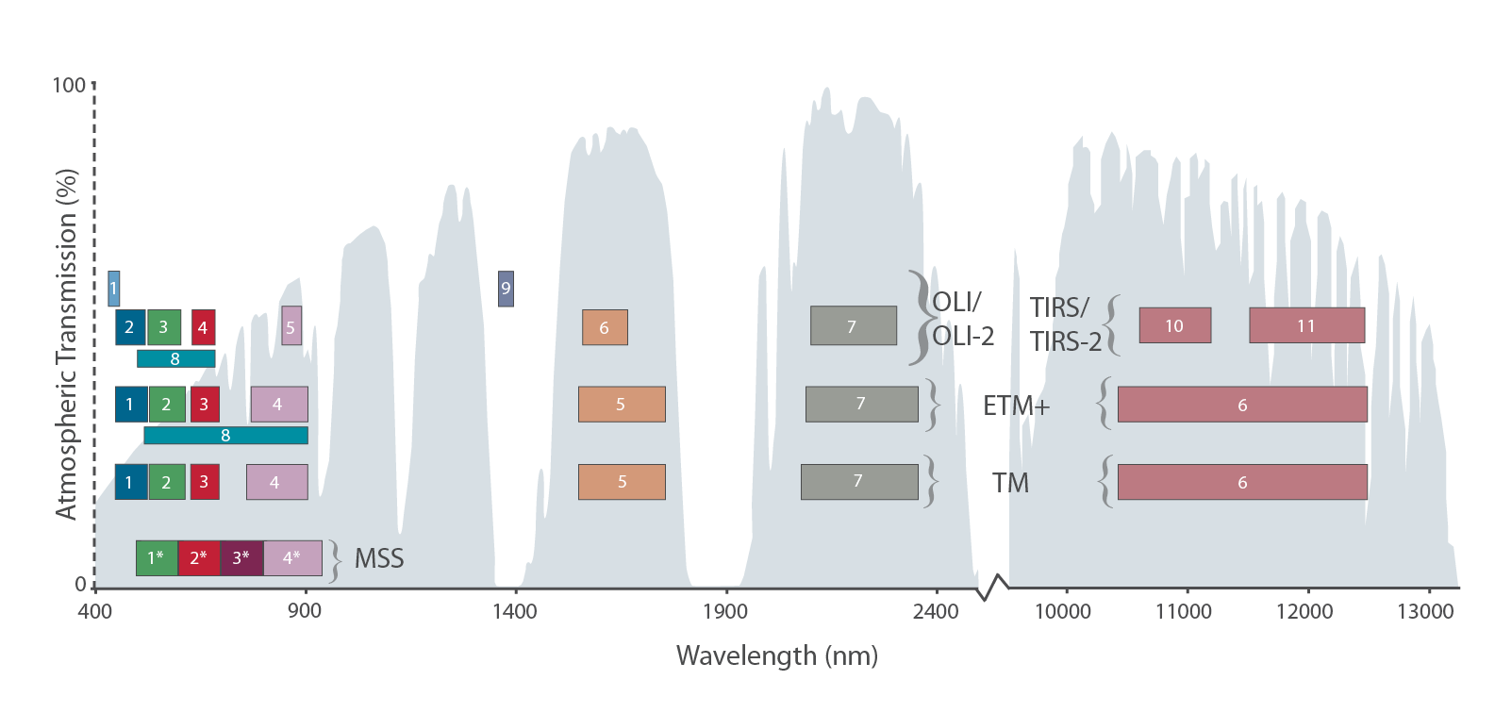
Near-
Infrared
Visible
Shortwave Infrared (SWIR)
Thermal Infrared (TIR)

Slide 19
Near-
Infrared
Visible
Shortwave Infrared (SWIR)
Thermal Infrared (TIR)
(plants)

Slide 20
Near-
Infrared
Visible
Shortwave Infrared (SWIR)
Thermal Infrared (TIR)
(plants)
(burn scars, geology, soil moisture)

Slide 21
Near-
Infrared
Visible
Shortwave Infrared (SWIR)
Thermal Infrared (TIR)
(plants)
(burn scars, geology, soil moisture)
(plant health, thermal stresses)

Slide 22
Near-
Infrared
Visible
Shortwave Infrared (SWIR)
Thermal Infrared (TIR)
(plants)
(burn scars, geology, soil moisture)
(plant health, thermal stresses)
What are these for???

Slide 23
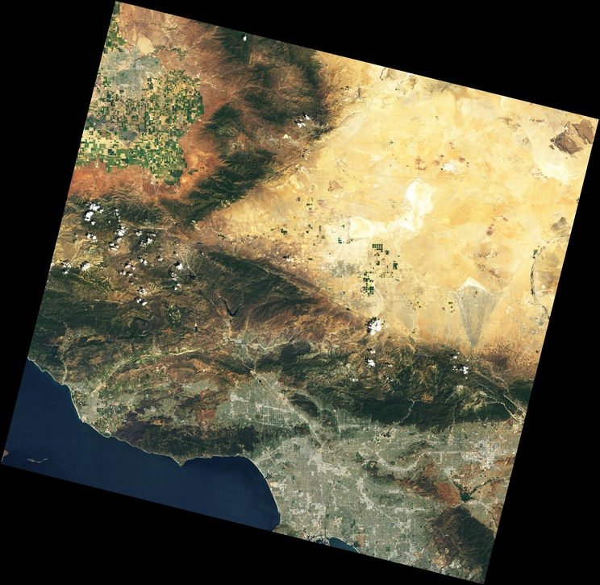
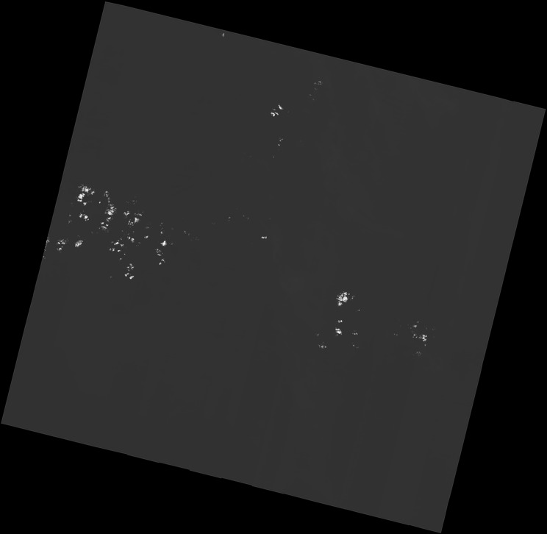
True Color Composite
Landsat 8
Band 9, or “Cloud Band”
Landsat 8

Slide 24
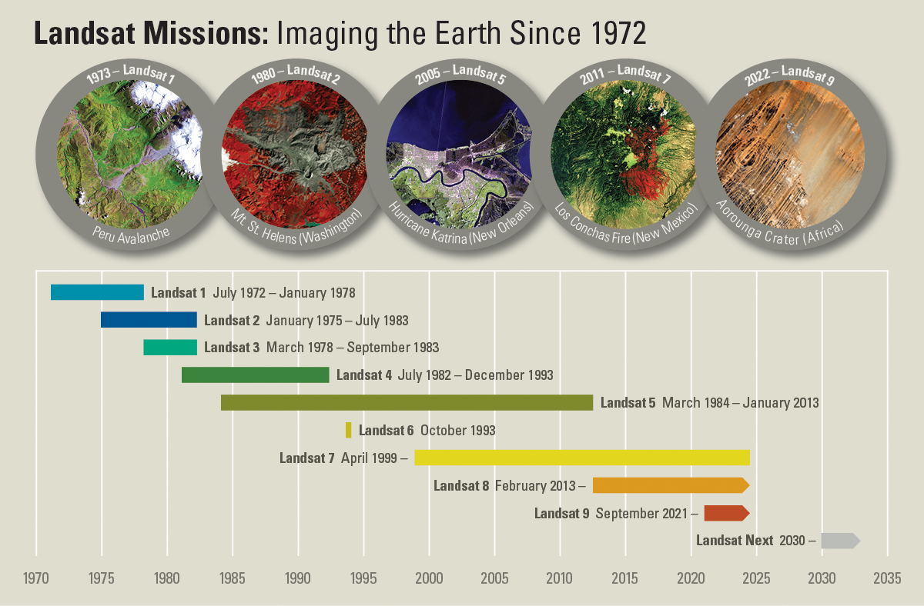

Slide 25

Continuity, continuity, continuity!
Bruce Cook Project scientist for Landsat Next

Slide 26
When do we use Landsat?
PROS:
Very, very, very long time series
Incredibly high-quality sensors – well-calibrated, intercomparable
Access to a thermal band
Publicly available (like most NASA data)

Slide 27
When do we use Landsat?
PROS:
Very, very, very long time series
Incredibly high-quality sensors – well-calibrated, intercomparable
Access to a thermal band
Publicly available (like most NASA data)
CONS:
30m spatial resolution can be too coarse for highly heterogeneous environments
Every two weeks can be too infrequent, especially in cloudy places

Slide 28
When do we use Landsat?
PROS:
Very, very, very long time series
Incredibly high-quality sensors – well-calibrated, intercomparable
Access to a thermal band
Publicly available (like most NASA data)
CONS:
30m spatial resolution can be too coarse for highly heterogeneous environments
Every two weeks can be too infrequent, especially in cloudy places
Excellent use cases: Long-term change monitoring and large-scale data analysis, anything thermal

Slide 29
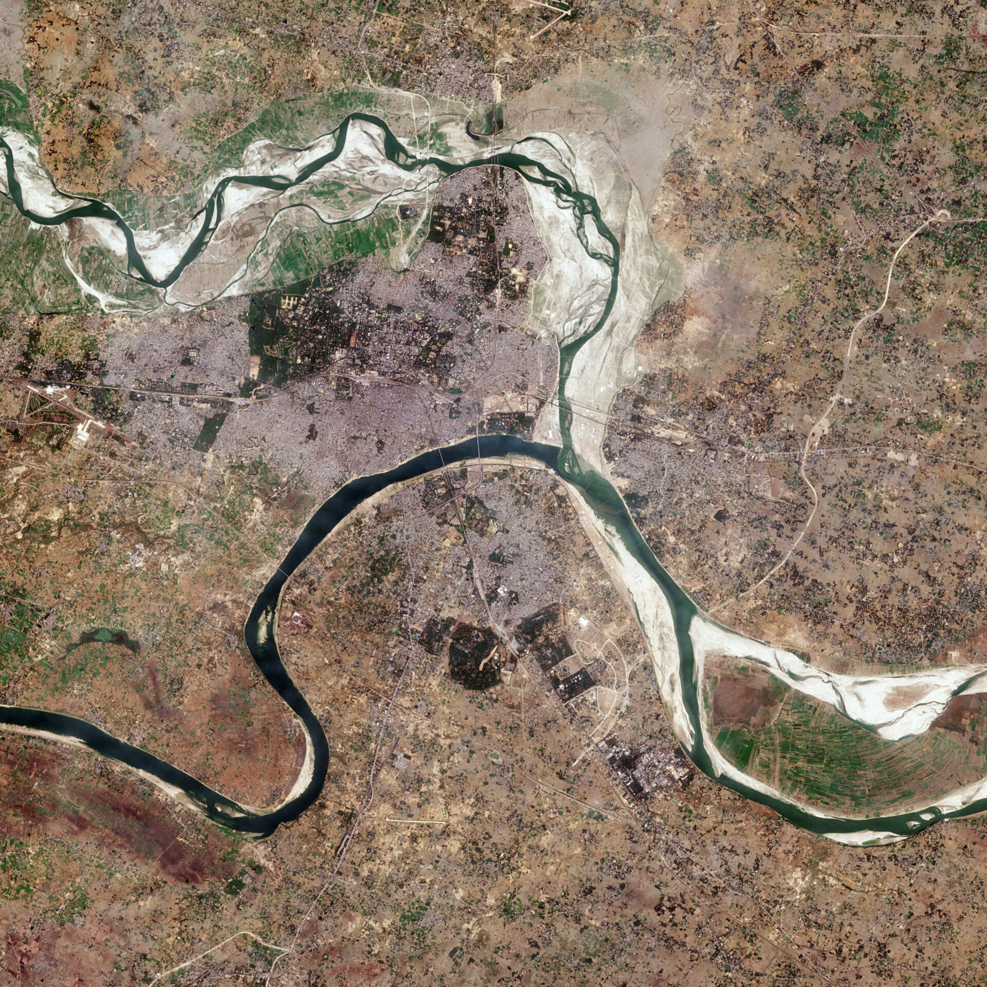

Sentinel-2
The Sentinel series isn’t like Landsat – all the Sentinel-#’s are very different from each other!
Quick Facts:
3 satellites – Sentinel-2A, Sentinel-2B, Sentinel-2C – offering higher revisit time
Higher resolution than Landsat (10-20 meters)
Close to a decade of imagery (launched in 2015, 2017, 2024)

Slide 30
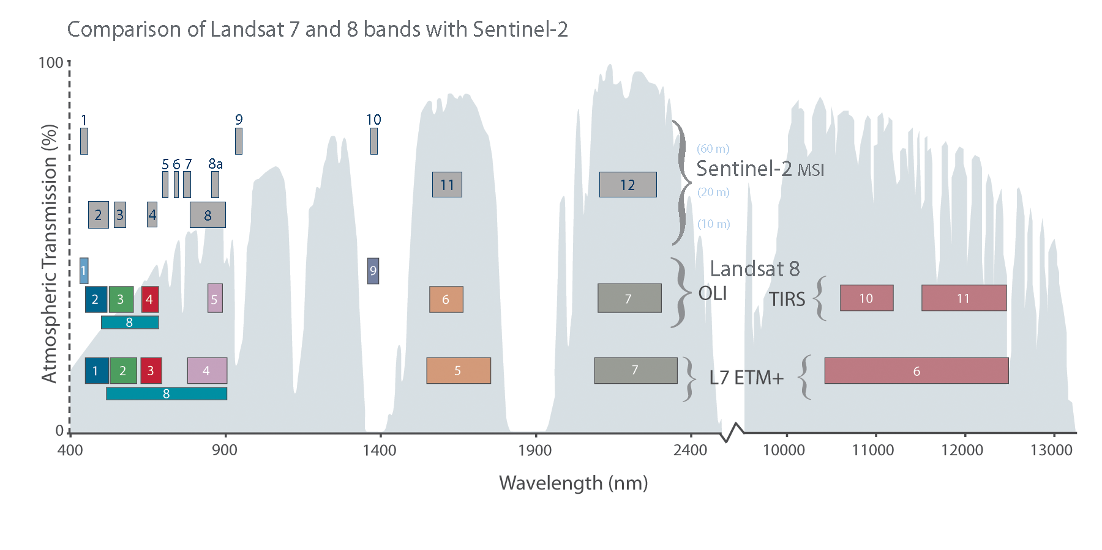

Slide 31
“Red Edge”
Bands

Slide 32
When do we use Sentinel-2?
PROS:
Higher spatial resolution than Landsat
A few extra spectral bands that are especially useful for vegetation
Shorter revisit time than Landsat

Slide 33
When do we use Sentinel-2?
PROS:
Higher spatial resolution than Landsat
A few extra spectral bands that are especially useful for vegetation
Shorter revisit time than Landsat
CONS:
Shorter time series than Landsat
No thermal bands

Slide 34
When do we use Sentinel-2?
PROS:
Higher spatial resolution than Landsat
A few extra spectral bands that are especially useful for vegetation
Shorter revisit time than Landsat
CONS:
Shorter time series than Landsat
No thermal bands
Excellent use cases: Vegetation analyses, analyses in heterogeneous environments (e.g., urban), time series analysis

Slide 35
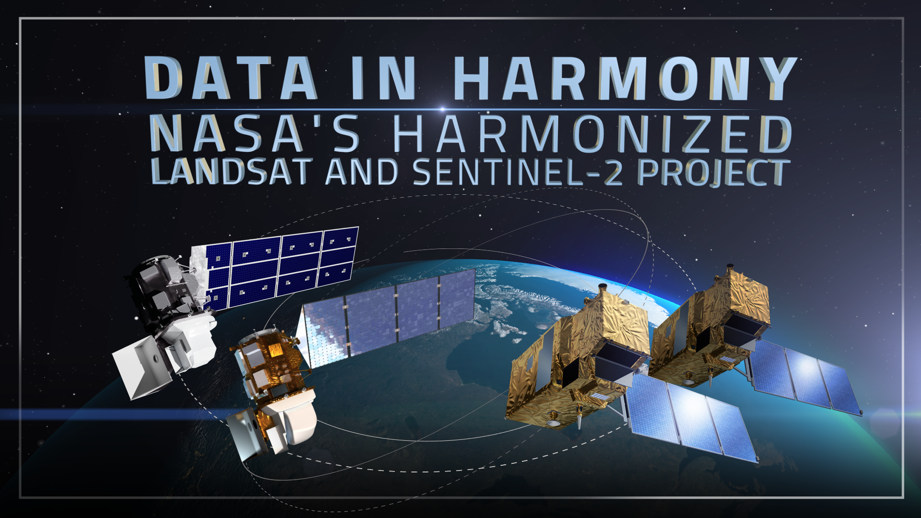
2-3 day revisit times at 30 meter resolution!

Slide 36
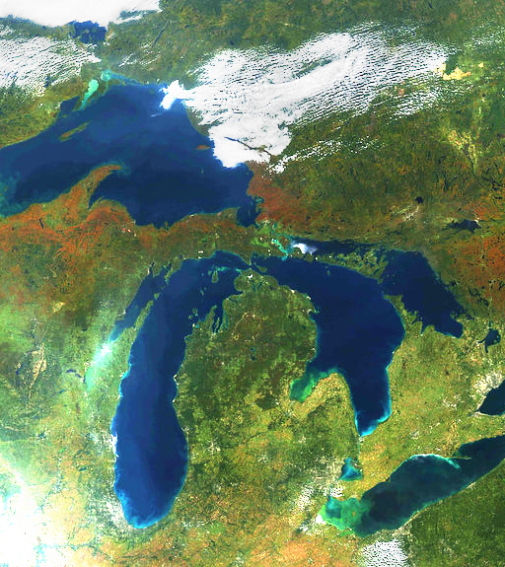
MODIS
Same instrument mounted on two different satellites (Terra/Aqua)
Quick Facts:
Launched in 2000 & 2002 (and probably running out of time…)
36 spectral bands (holy cow!), including thermal and many designed for atmospheric and oceanic applications
Daily revisit time
Fairly coarse spatial resolution (250-1000m)

Slide 37
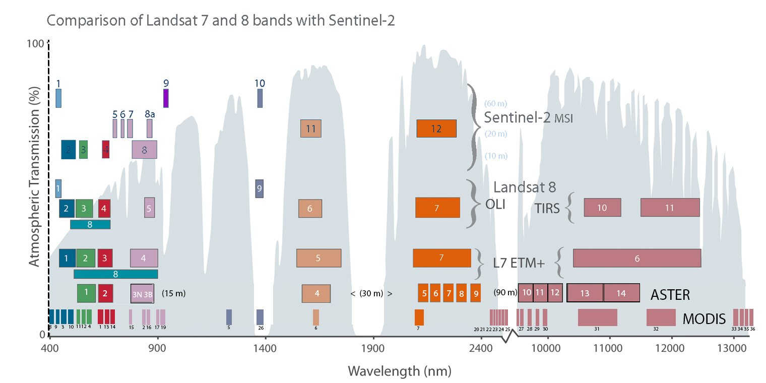

Slide 38
When do we use MODIS?
PROS:
Has thermal at two different times of day (~10:30am on Terra and ~1:30pm on Aqua)
Daily revisit
Has bands designed for ocean color/phytoplankton
CONS:
Very coarse!
Excellent use cases: Wildfire, thermal stress monitoring, ocean remote sensing

Slide 39
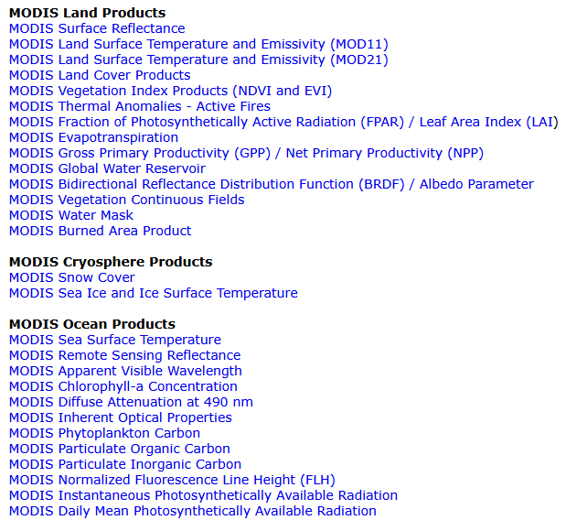
The Swiss Army Knife of remote sensing…
I think of MODIS as having an amazing amount of derived products.
These are made using algorithms produced by talented teams of specialists.
Many of them aren’t perfect but they are all good!

Slide 40


PlanetScope
“Constellation” of many satellites
Quick Facts:
Over 200 cubesats currently in orbit (exact number has varied over time)
Started in 2014
4 spectral bands (RGB/NIR)
3.5 meter spatial resolution
Commercial satellite constellation – data is generally not publicly available, but we have a license!

Slide 41
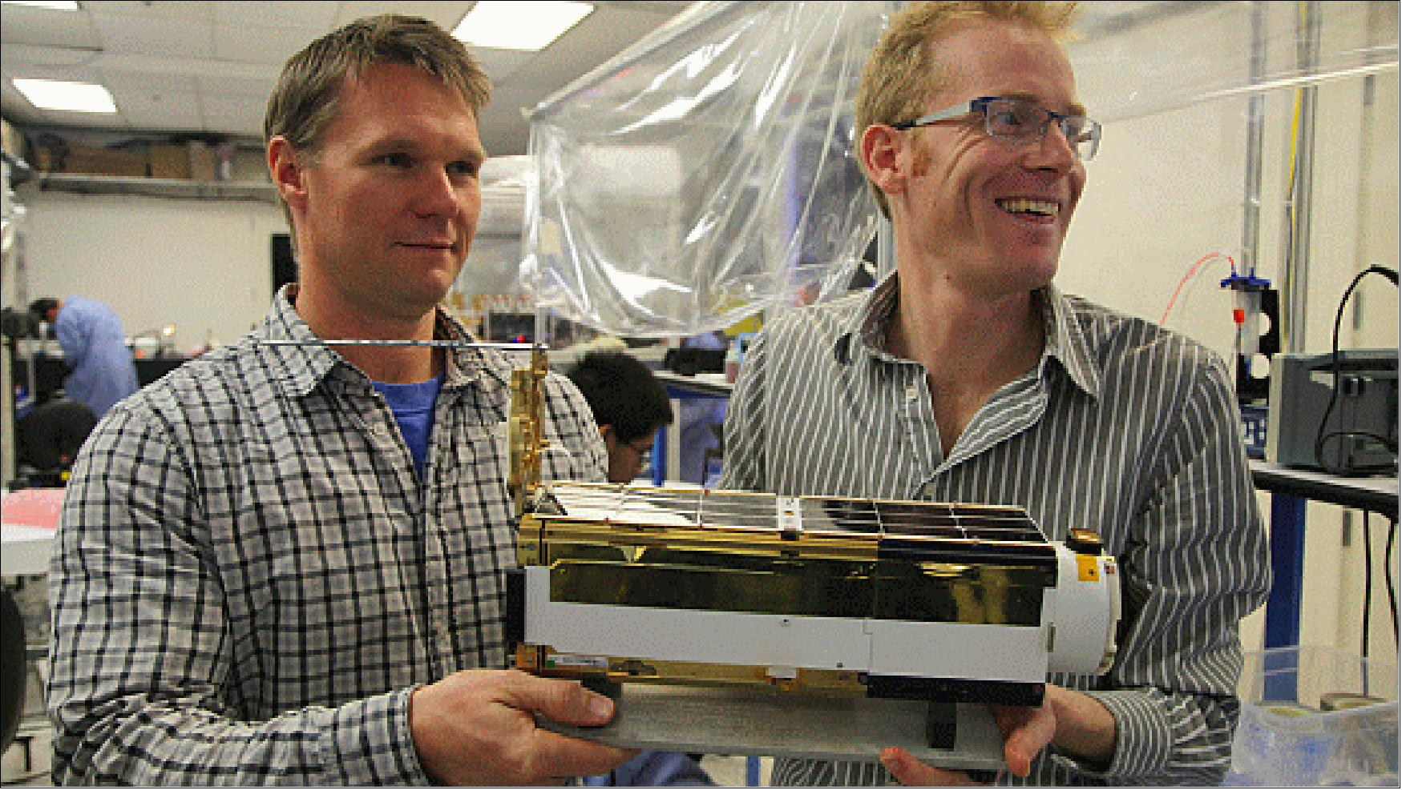
PlanetScope CubeSat

Slide 42
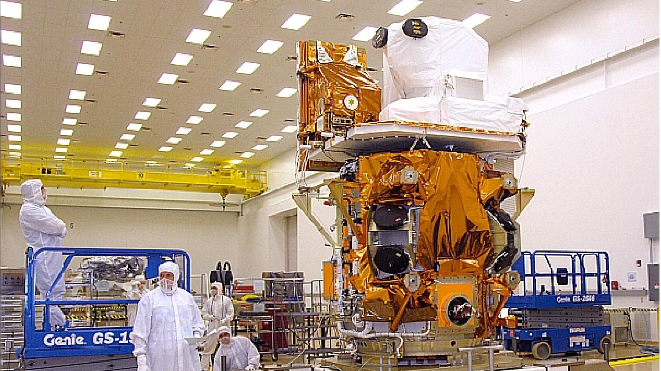
Landsat 8

Slide 43
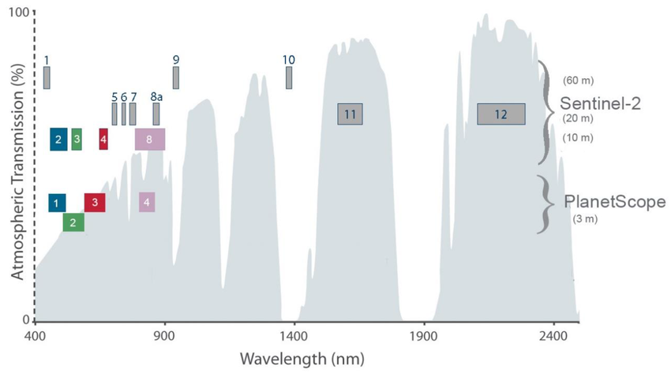

Slide 44
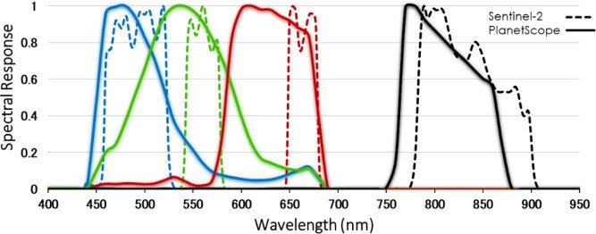

Slide 45
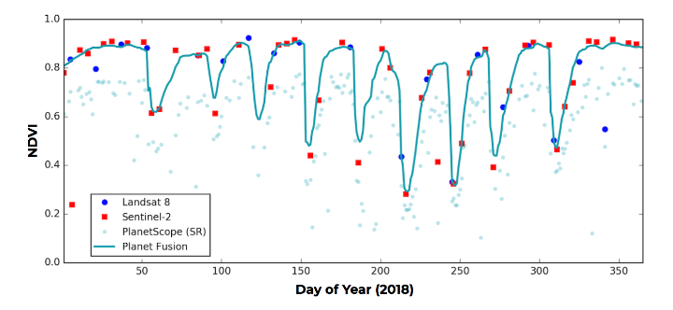
Source:
Planet Fusion Monitoring Technical Specification

Slide 46
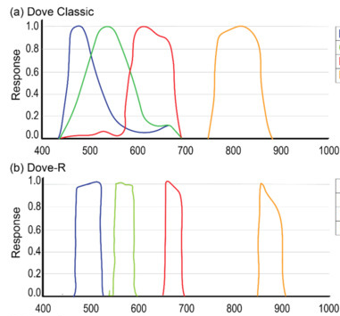
The newer satellites (Dove-R, or PS2.SD) have spectral response functions that are more comparable to research-grade instruments (e.g., Landsat).
The new Dove-R satellites started being launched in 2019 and the “Dove Classic” satellites were phased out over time.

Slide 47
When do we use PlanetScope?
PROS:
Very high resolution – perfect for heterogeneous environments and “spatially aware” analyses (e.g., image segmentation or object identification)
Very short revisit time (near-daily)

Slide 48
When do we use PlanetScope?
PROS:
Very high resolution – perfect for heterogeneous environments and “spatially aware” analyses (e.g., image segmentation or object identification)
Very short revisit time (near-daily)
CONS:
Variable instrument calibration/response functions causes noise in time series
High spatial resolution can create challenges when building classifiers
Only has visible/NIR bands

Slide 49
When do we use PlanetScope?
PROS:
Very high resolution – perfect for heterogeneous environments and “spatially aware” analyses (e.g., image segmentation or object identification)
Very short revisit time (near-daily)
CONS:
Variable instrument calibration/response functions causes noise in time series
High spatial resolution can create challenges when building classifiers
Only has visible/NIR bands
Excellent use cases: urban environments, vegetation

Slide 50
Landsat
1972-present
Visible, NIR, SWIR, Thermal
30 meter spatial resolution in VSWIR
100 meter spatial resolution in Thermal
~14-day revisit time
Sentinel-2
~2015-present
Visible, NIR, SWIR
10-20 meter spatial resolution
~5-day revisit time
Landsat/Sentinel Harmonized
2013-present
Visible, NIR, SWIR
30 meter spatial resolution
2-3 day revisit time
MODIS
2000-present (but not for long…)
Visible, NIR, SWIR, thermal, and more!
250-1000 meter spatial resolution
2x daily revisit time
PlanetScope
~2014-present
Visible, NIR
3.5 meter spatial resolution
Daily revisit time
How do we know what to use?

Slide 51
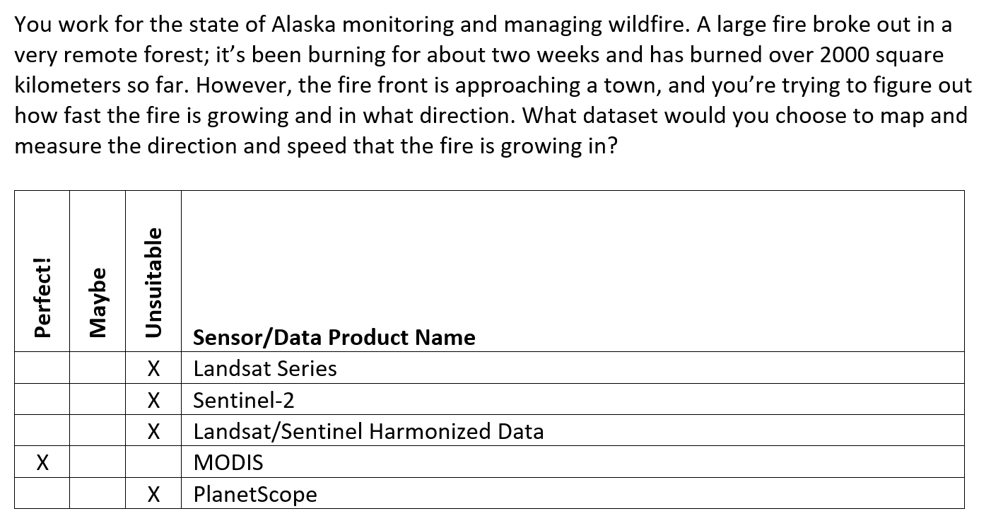

Slide 52
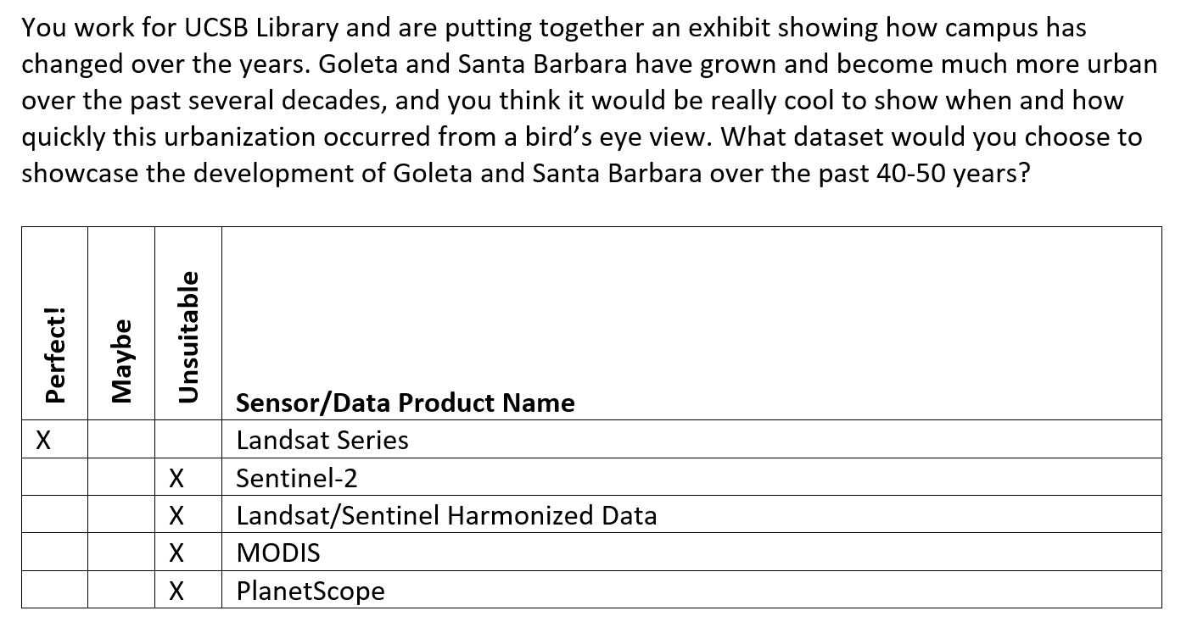

Slide 53
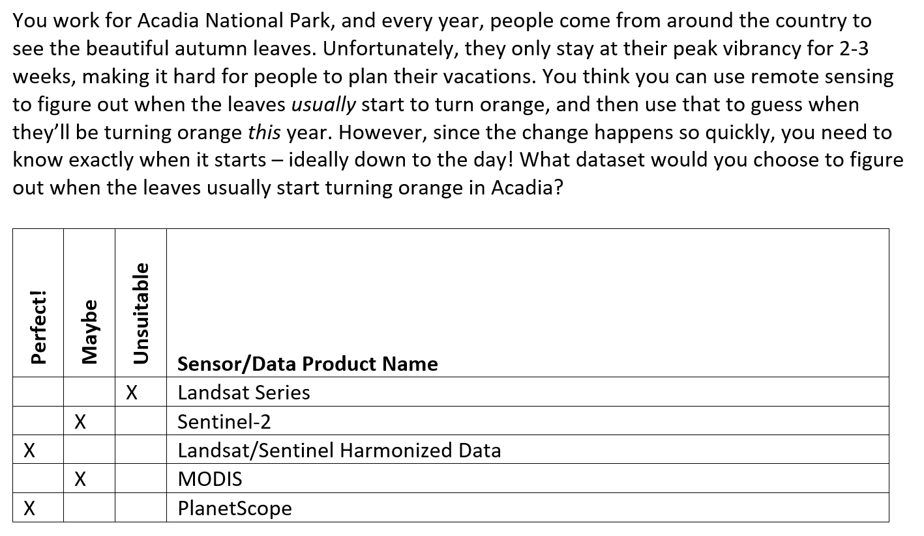

Slide 54
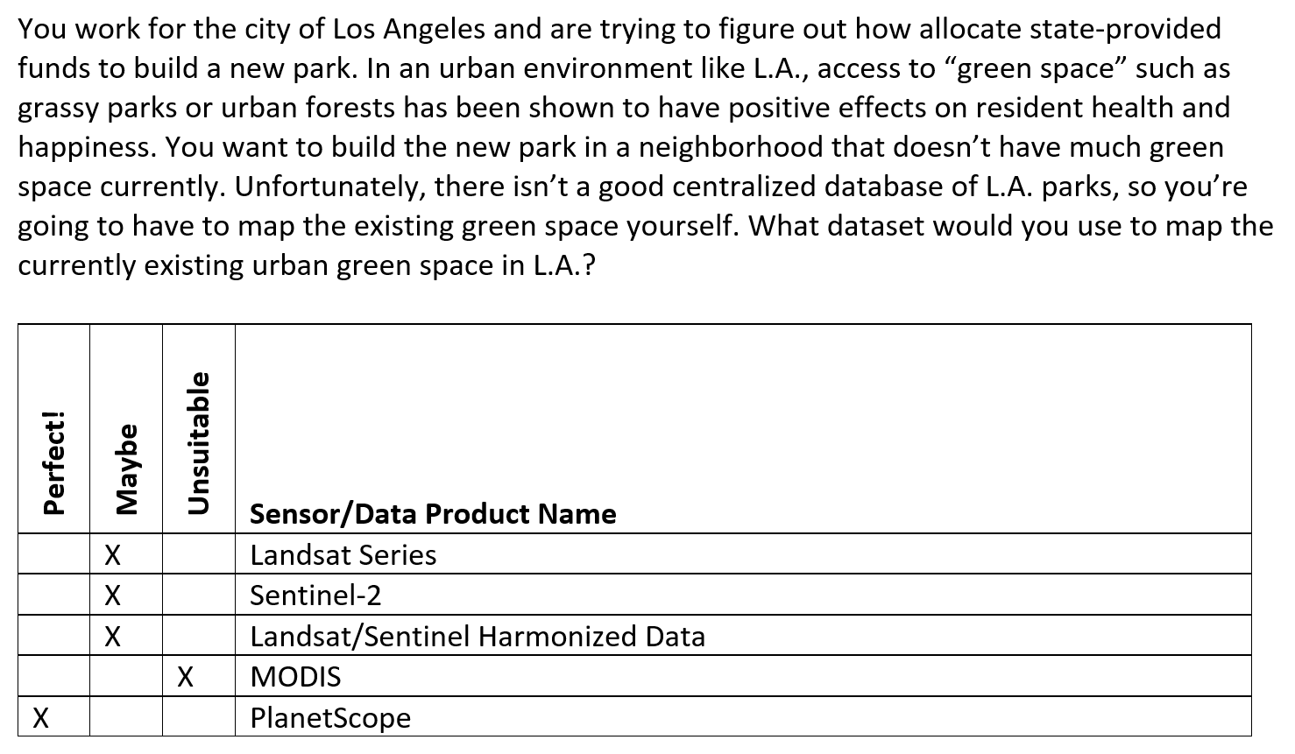

Slide 55
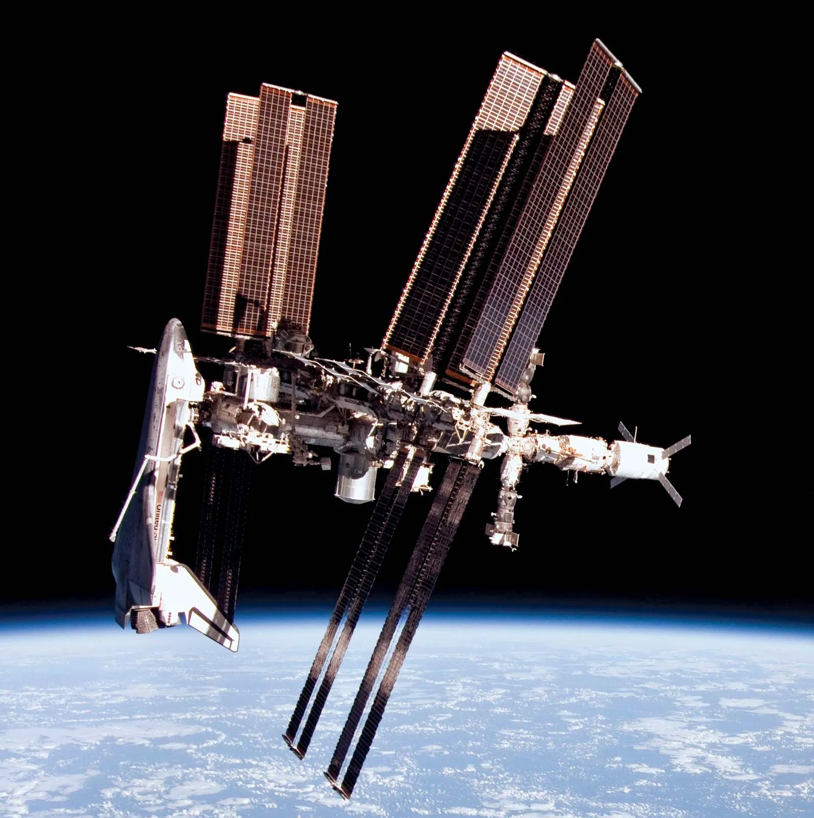
Bonus Activity: Meet the Specialists
By “specialists”, we mean sensors that were built for a specific purpose.
Some of them have their own dedicated satellite, but some are mounted on another satellite (for example, GEDI is mounted on the International Space Station).

Slide 56
Bonus Activity: Meet the Specialists
Sensor List:
GEDI (NASA/UMD)
EMIT (NASA)
ECOSTRESS (NASA)
SMAP (NASA)
PACE OCI (NASA)
The GOES Series (NOAA/NASA)
The GRACE Series (NASA)
The IceSat Series (IceSat-1, Operation IceBridge, IceSat-2)
Try to find:
What year was this sensor deployed? Is it still active/when did it end?
For passive systems, what bands does it have?
For active systems, what kind of instrument is it (LiDAR/RADAR)?
What spatial resolution does it have?
What was it designed to do/what are some good potential use cases?

Slide 57


Slide 58


Slide 59


Slide 60
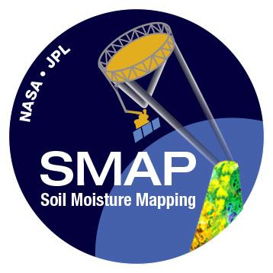

Slide 61


Slide 62


Slide 63
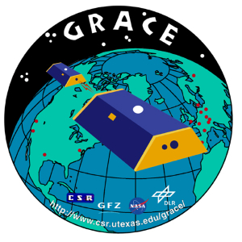

Slide 64




Slide 65

Amazing Work!!!
Turn in your sheet at the front so I can count it for attendance.
Fill out the group selection form by the end of the day Friday.
Lab assignment is due before the start of next week’s lab section.
First reading assignment is due before class next Monday.
If attending office hours today, come talk to me after class!

